Slide 1
Embracing Human Centric Design
The Future of User Experience

Slide 2
Your next
45 mins
Segment 1
Segment 2
Design Thinking Vs Product Development
Human Centered Design
Finally, Incorporating these learned best practices into our work will empower us to consistently deliver user-centered solutions and drive innovation in our projects
Why, What and How.
Why & How.
Notes:
Suj

Slide 3
Future- proofing
Business through design
21 Years
8.9M+
Mixed Reality
Average years spent by humans in front of any form of digital experience
Approximate number of apps in the world
What not?
Notes:
Suj

Slide 4
Approaches to design build a desirable product
5. Surface
Visual Experience (High Fidelity Mock-ups, Prototypes)
4. Skeleton
3. Structure
Information, Interface & Navigation Design (Wireframes, Prototypes, UX Writing / Microcopy)
Interaction Design & Information Architecture (Sitemaps, User Flows)
2. Scope
Features & Content Requirements (Brainstorming, Content Strategy)
Strategy
User Needs & Product Objectives (Personas, Storyboards, Journey Maps)
Notes:
Tej

Slide 5
When attempting to solve a wicked problem
Focus on root cause than the symptom
Sed ut perspiciatis unde omnis iste natus error
Root Problem
Notes:
Suj

Slide 6


Design Thinking, a human-centric problem solving
approach
Define
Ideate
Starts with
Prototype
Empathy
A wonderful serenity has taken possession of my entire
Test
Notes:
Tej

Slide 7
Step 1
Human-Centered Design
Looking for core/root cause rather than the symptoms
Step 2
Focus on People and their needs
Step 3
Everything is a system. Practice System Point of view
Step 4
Test & redefine the proposed solution to mee the end user needs
Principles to follow
A wonderful serenity has taken possession of my entire soul
Notes:
Suj

Slide 8


We Transform threats of the digital future into opportunities
12
Sustainability in Design
Data Privacy and Ethical Design
The Eco-Friendly badge on Ecosia, a search engine that plants trees with its ad revenue, communicates its commitment to sustainability
Inclusive Design and Accessibility
Progressive Web Apps (PWAs)
Twitter Lite is a PWA that offers a faster and more data-efficient experience for users on slower networks or with limited data plans
Apple's App Tracking Transparency feature gives users more control over how their data is used for targeted advertising.
Microsoft's Xbox Adaptive Controller, designed to be accessible to gamers with limited mobility, is a notable example of inclusive design.
8
Notes:
Suj

Slide 9
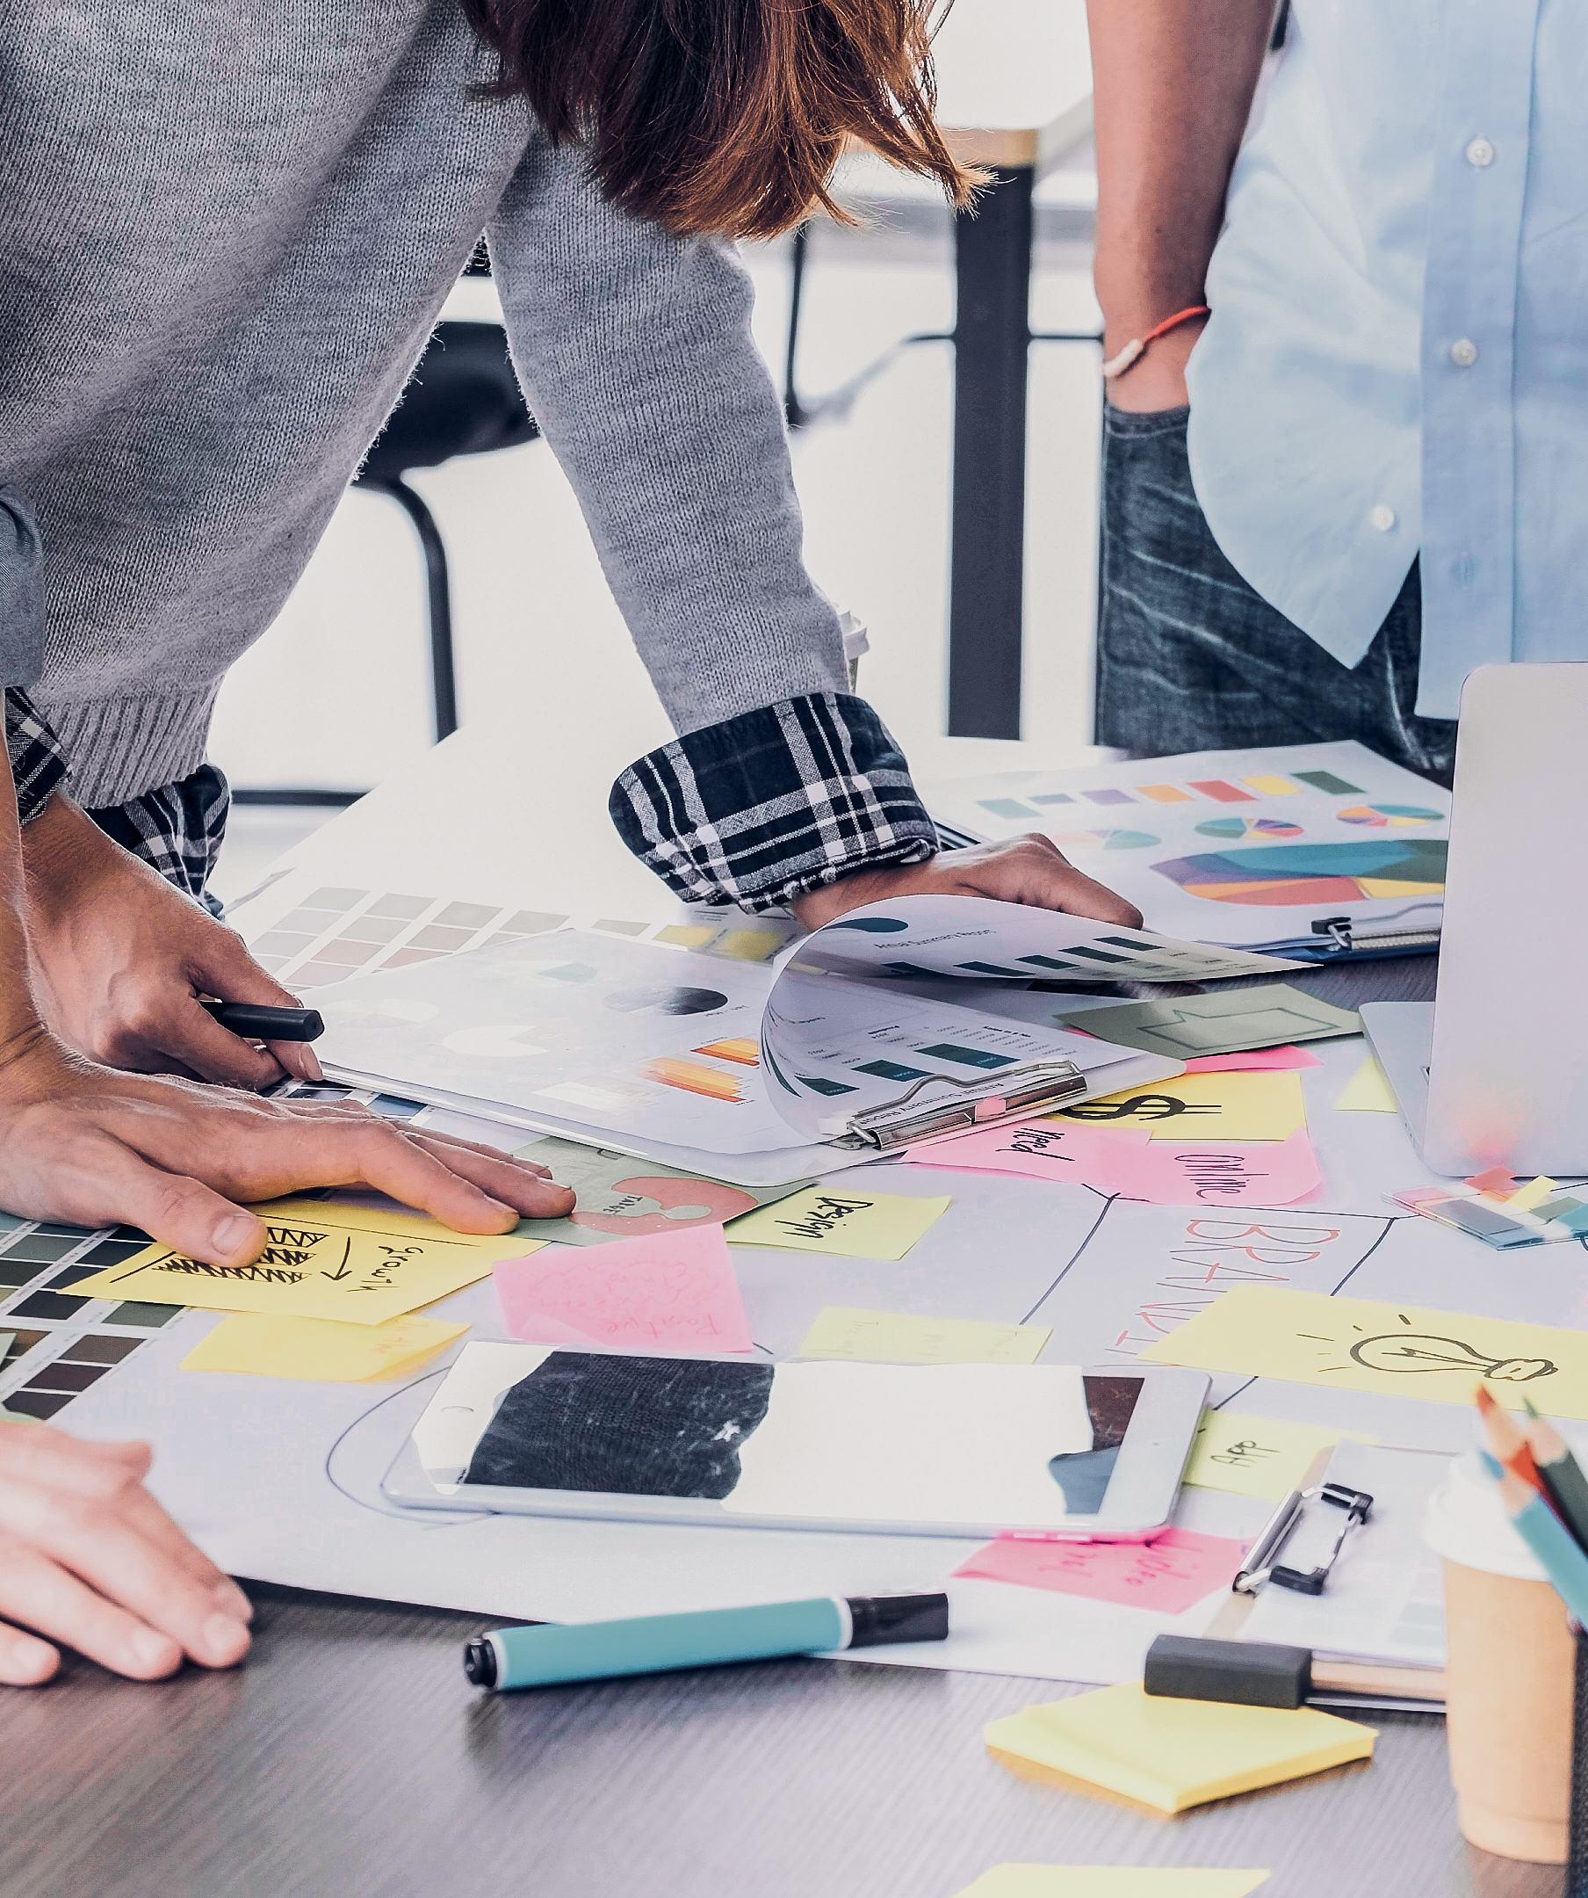


User Research
Conduct in-depth user research to understand the target audience
Interviews, surveys, and observations to gather insights into user behaviors, needs, and pain points
Strategies
to make it work
Empathy Building
Encourage team members to empathize with users by putting themselves in their shoes
Cross-Functional Collaboration
Foster collaboration among team members with diverse skills and perspectives
9
Notes:
tej

Slide 10
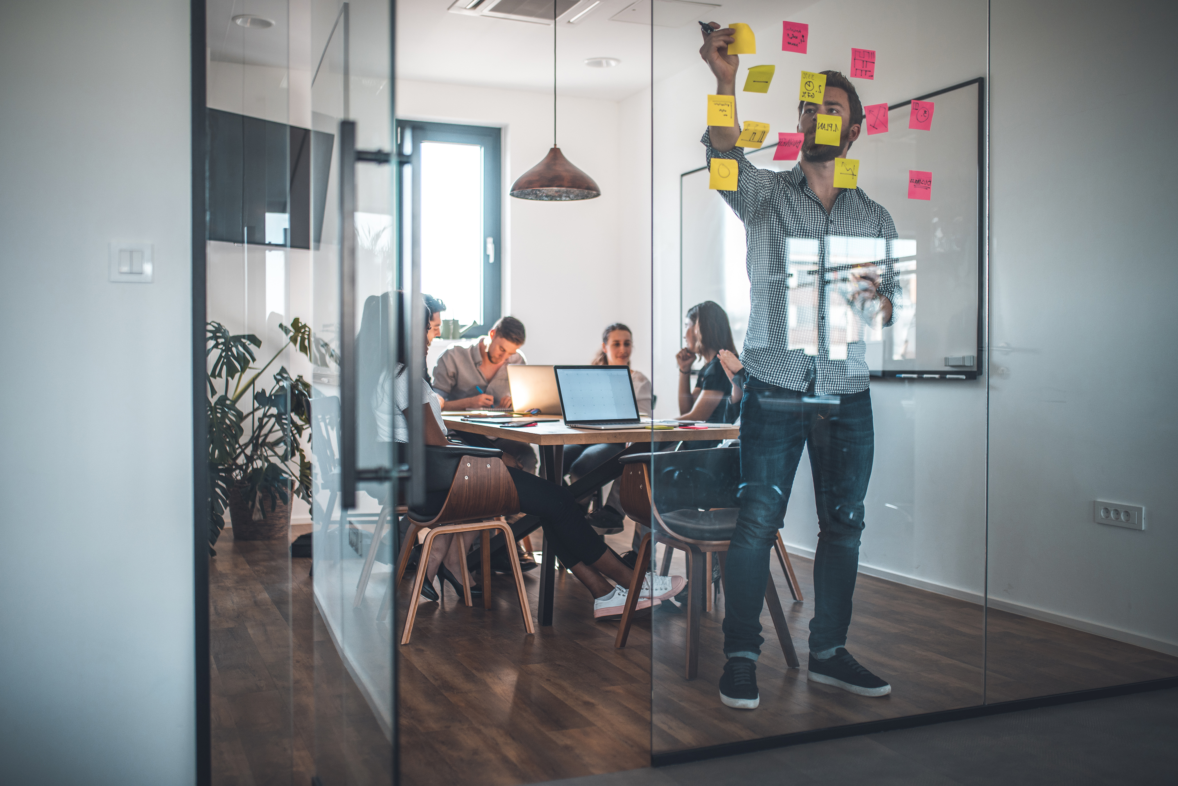

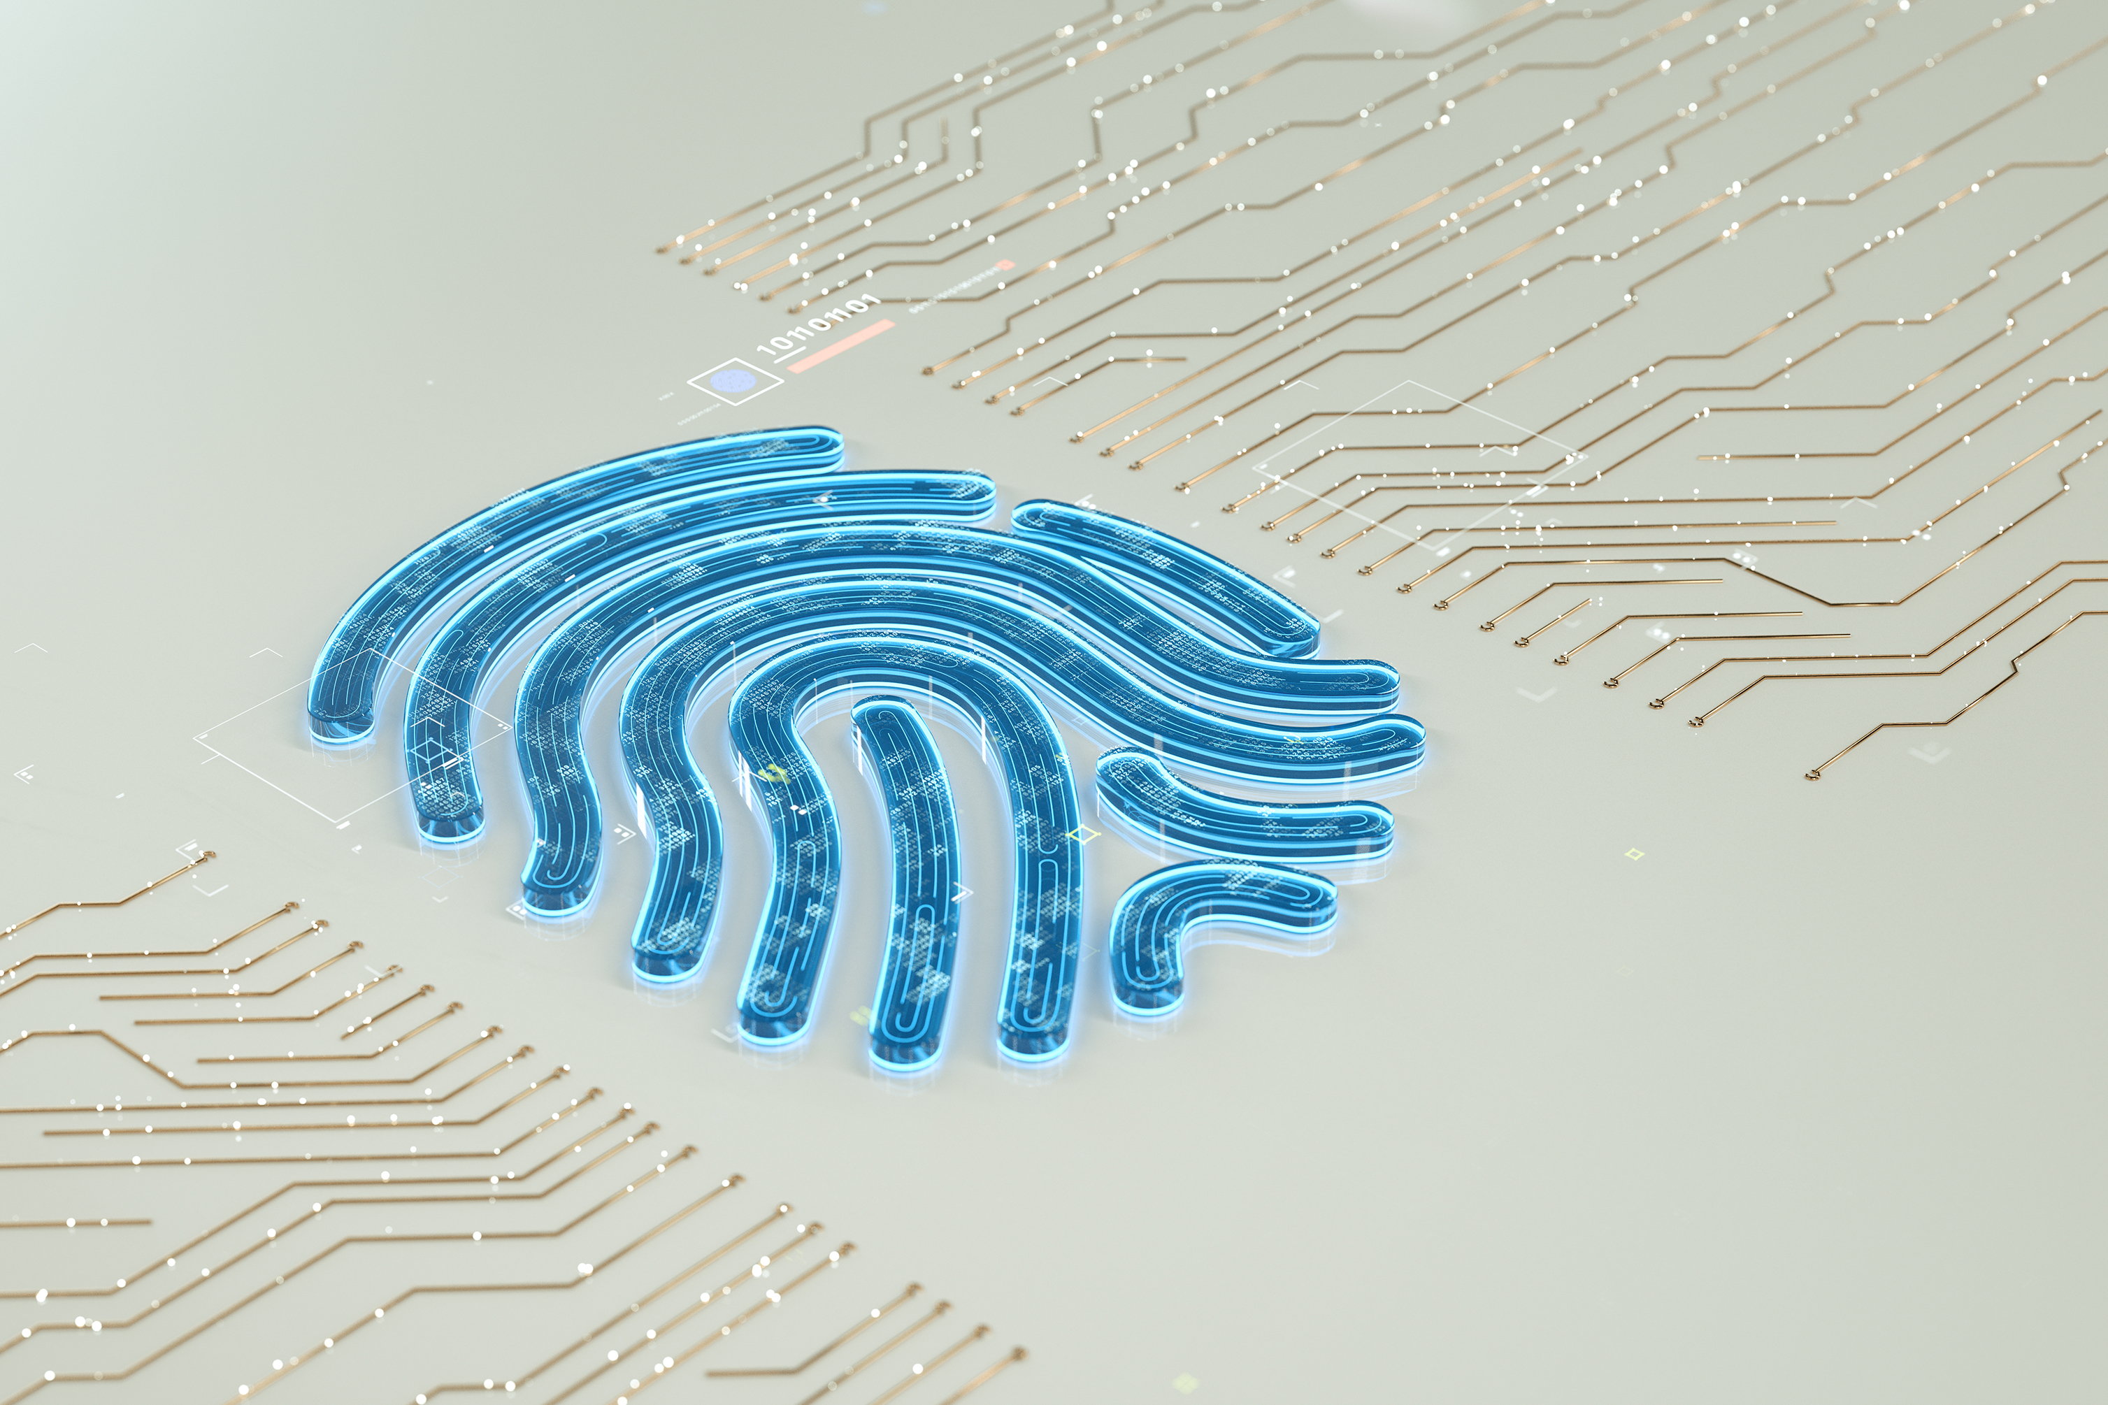
Design Thinking Workshops
Engage team members in ideation sessions to generate innovative solutions
There is no one-size fits all solution
User-Centric Metrics
Metrics such as user satisfaction, task success rates, and conversion rates can provide valuable insights into the effectiveness of your design.
Ethical Considerations
Incorporate ethical considerations into your design process, addressing issues like data privacy and user consent
10
Notes:
Suj

Slide 11
Unleash your
Curious minds....
In the realm of knowledge, the power of inquiry is immeasurable
Notes:
Together

Slide 12
Which of the above topics or principles do you practice in your day-to-day life?
Mixed Reality
What not?
Notes:
Suj

Slide 13
Who are we building product for?
Mixed Reality
What not?
Notes:
Suj

Slide 14
Which product according to you is more Human Centric?
Mixed Reality
What not?
Notes:
Suj

Slide 15
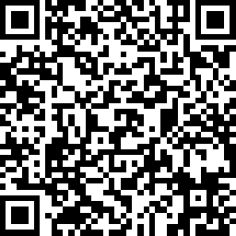
Please provide your feedback
Mixed Reality
What not?
Notes:
Suj

Slide 16

Thank You
Sujithra Gunasekaran
Product Manager
Sujithra.g@presidio.com
Tejaswini
Business Analyst
Tejaswini.natarajan@presidio.com

Slide 17
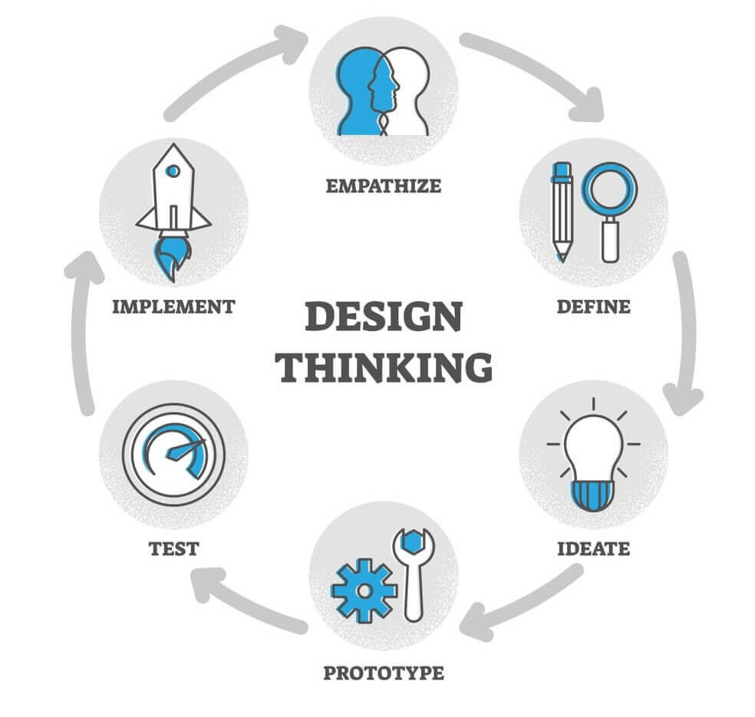
What is Design Thinking?

Slide 18
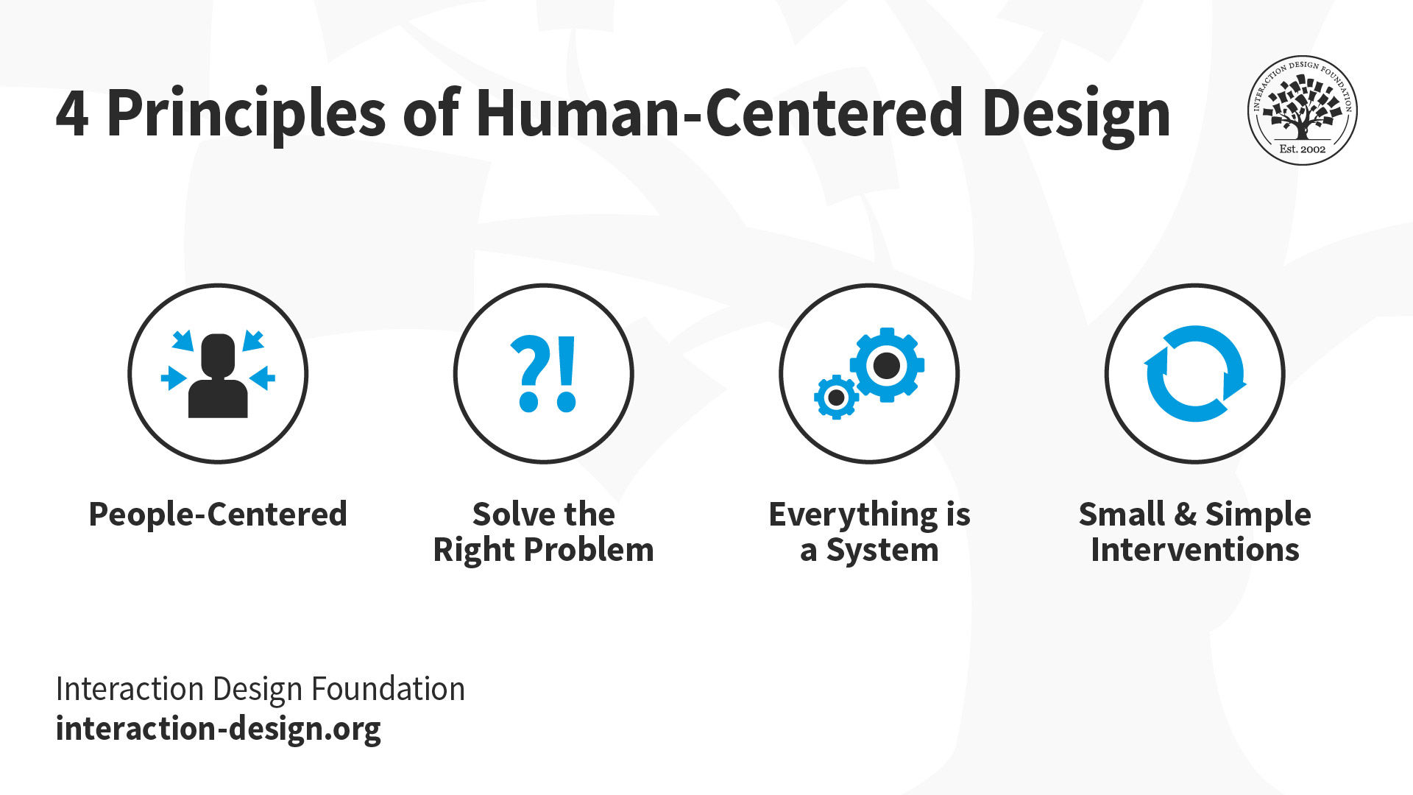
What is Human Centric Design
Human-Centered Design (HCD) is an approach to problem-solving and innovation that prioritizes the needs, preferences, and experiences of the end-users. It is a user-focused design process that aims to create products, systems, or services that are not only functional and efficient but also enjoyable and meaningful for the people who use them. The fundamental principles of Human-Centered Design include empathy, iteration, and collaboration.

Slide 19






Emerging Trends Shaping the Future of User Experience

Slide 20
How to implement Human Centric Design
User Research
Empathy Building
Iterative Design Process
Cross-Functional Collaboration
User Testing
Accessibility
Prototyping
HUMAN CENTRIC DESIGN
Need to fix order

Slide 21
Challenges in implementing Human Centric Design
Limited Resources
Resistance to Change
Assumptions and Biases
Lack of User Involvement
Tight Timelines
Accessibility Challenges
Balancing Stakeholder Needs
Data Privacy Concerns
Rapid Technological Changes
Global and Cultural Variations

Slide 22
Thank you !
Designing with empathy and understanding is not just good for the users its good for the business too !

